Slide 1
Soccer Codebase
RoboCup Software Training 2019

Slide 2
Post - Install Configuration - Git Settings
These commands set up your git attributes
git config --global user.name “Your Name”
git config --global user.email “your@email.here”
Adding remotes these commands set you up to push to your fork by default, and still able to receive updates
cd robocup-software
git remote add rj https://github.com/RoboJackets/robocup-software.git
git remote set-url origin https://github.com/<YOUR_GT_USERNAME>/robocup-software.git
git remote -v
Staying Updated
git pull rj master
git push origin master

Slide 3
Build Commands
Command | Description
make | Compiles rc-software
make run | Runs Soccer with no simulator
make run-sim | Runs Soccer with simulator
make debug | Runs Soccer in a debugger
make debug-sim | Runs Soccer in a debugger + simulator
Make run-headmore | Runs Soccer with simulator and grSim visualization
Make run-sim2play | Runs two instances of Soccer with simulator to play against yourself.

Slide 4

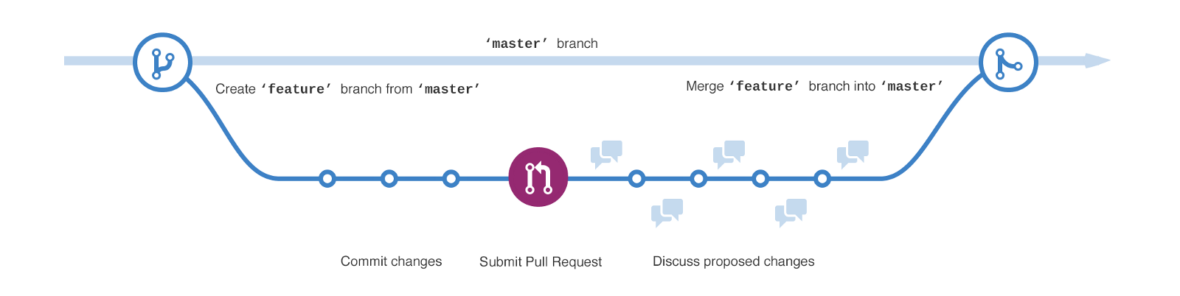
Make a branch
Checkout a new branch
git checkout -b my-feature
Checkout other branch
git checkout old_branch
staging
staging
staging

Slide 5

Committing Code To your fork
Add all your changed files to be committed
git add file_name.py
git add . (adds all files changed)
Make sure your files are all “green”
git status
Commit your message with a good status message
git commit -m “I’ve fixed the coach play to have a new cheer up feature”
Push to your fork
Git push origin <branch name>

Slide 6
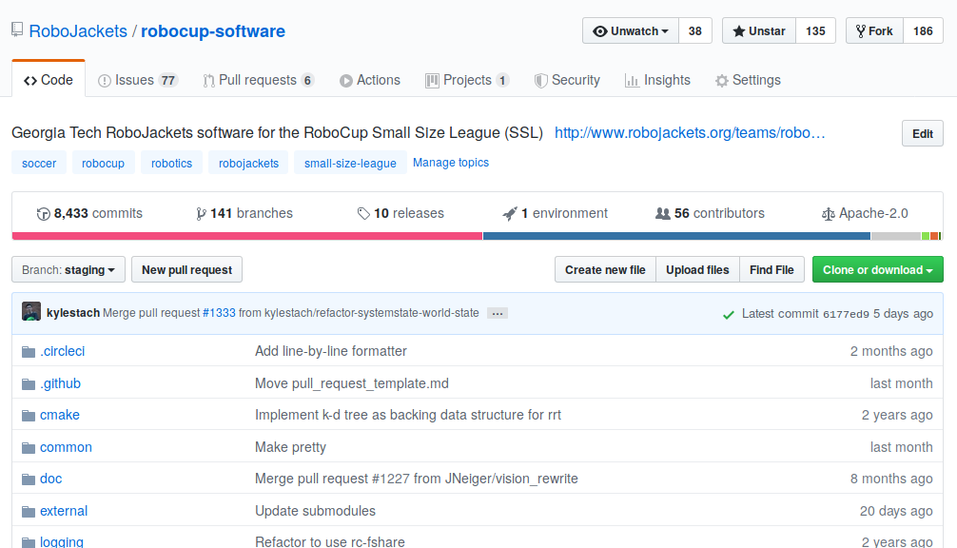
Using GitHub

Slide 7
MASTER
STAGING
FEATURE
FEATURE

Slide 8
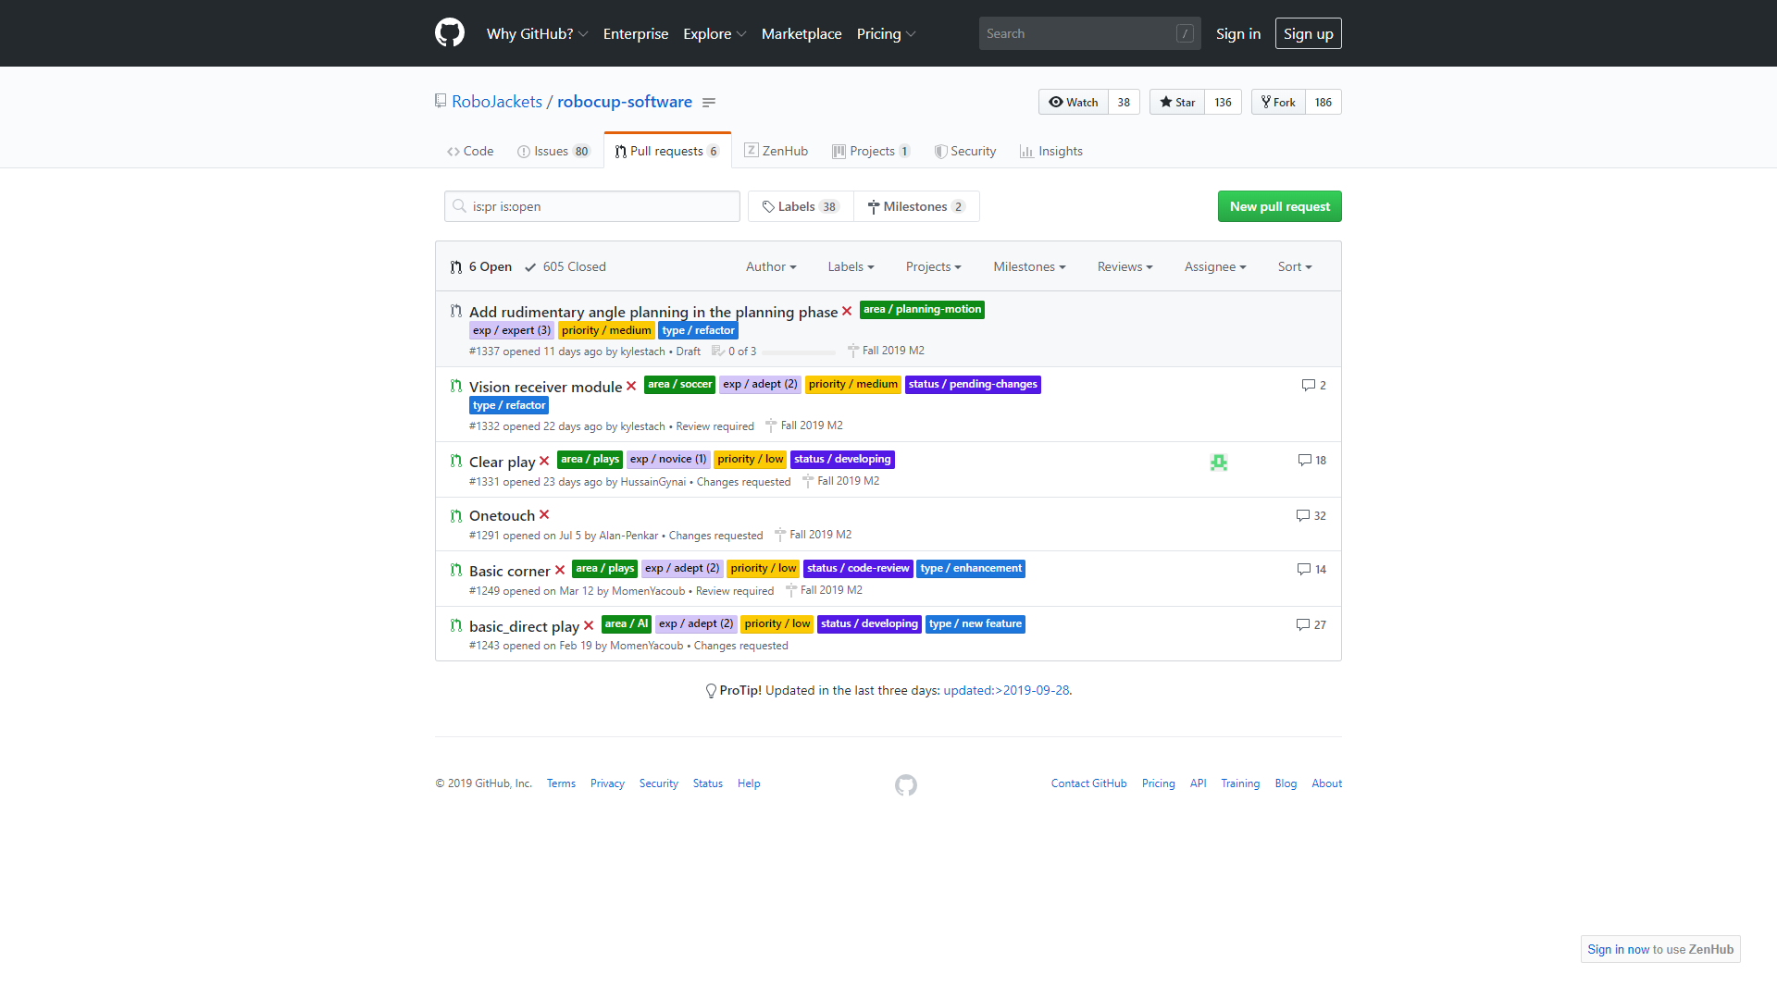
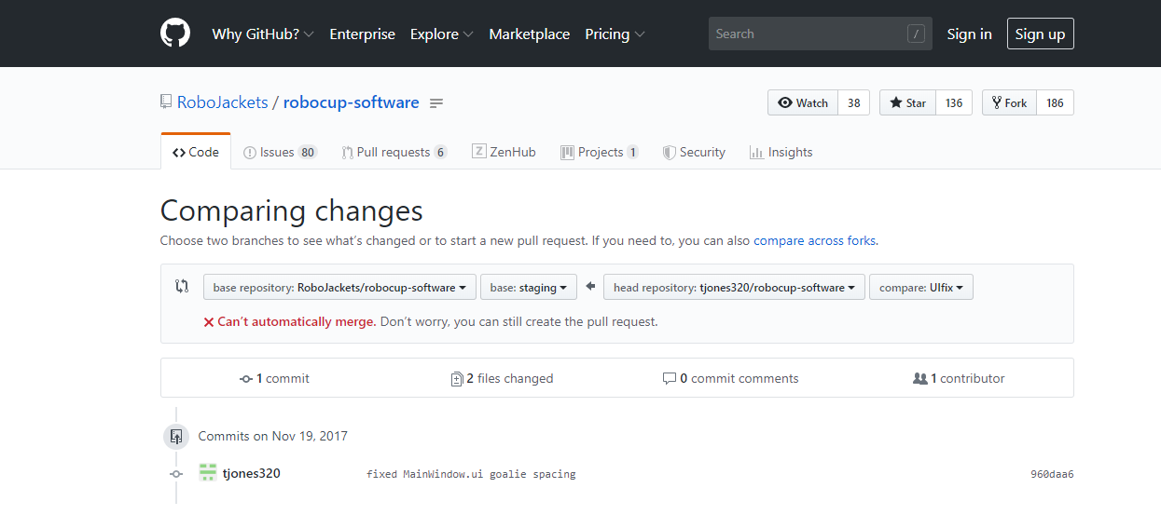
Pull Request
Create a new pull request
Click new pull requests
Click compare across forks
Select fork and branch
Click on “create pull request”

Slide 9
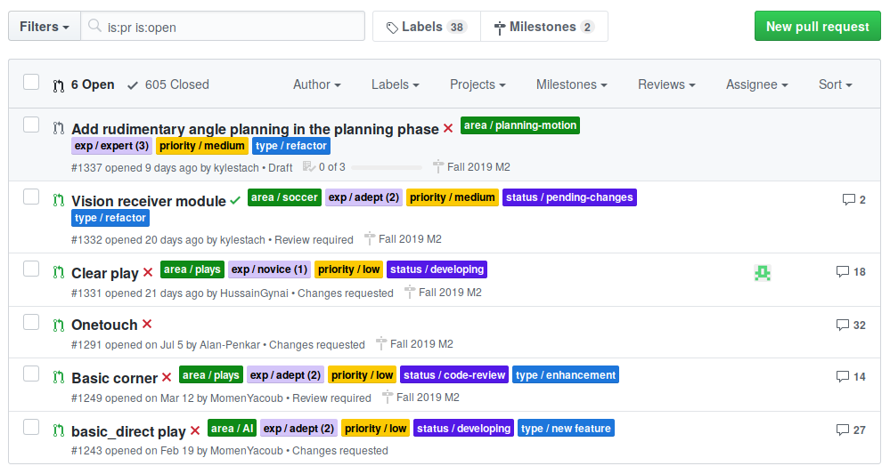
Pull Requests
Request to merge code into “staging”
Should be…
Atomic: should stand on its own
Correct: shouldn’t break anything
Small: should be easy to review

Slide 10
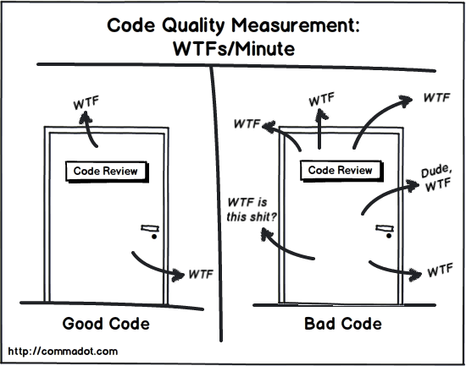
Code Review
Other people will check your code!
This is an opportunity for everyone
You can learn by making PRs
You can learn by doing code review
Major reviewer
Reviews code
Gives suggestions
Minor reviewer
Tests code
Reads code
Asks questions

Slide 11
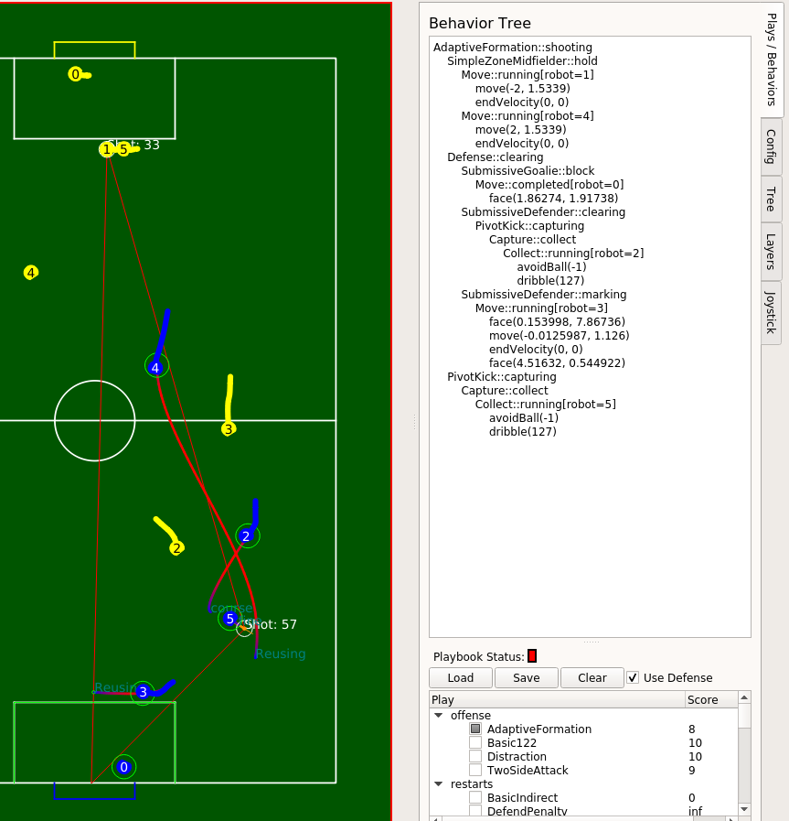
Milestones
1-month sprints
Schedule
Week 0 (end of previous sprint): decide what issues to take on
Week 1: work on issues
Week 2: work on issues, do code review
Week 3: 6v6 sim-testing day
Create testing document
Week 4: real-life testing day
Test on real robots!
Merge staging into master

Slide 12
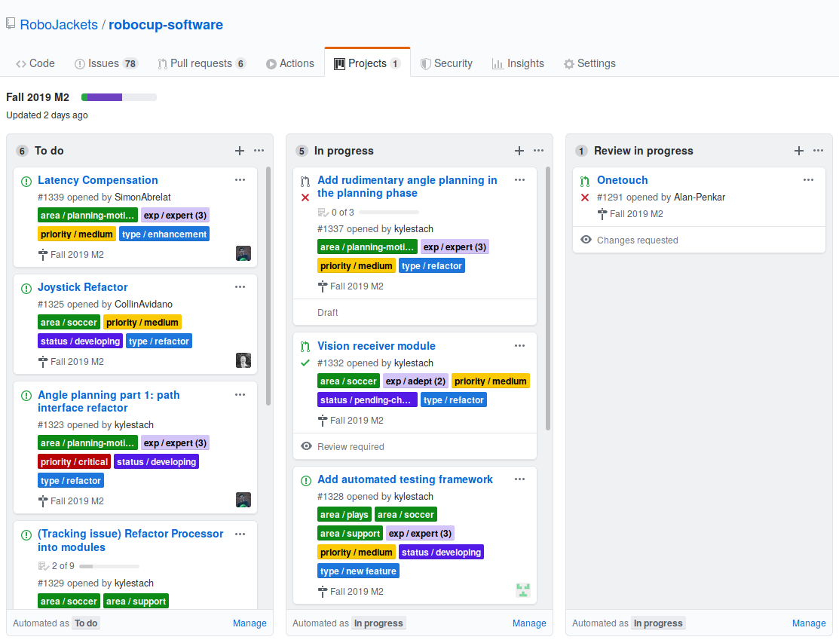
Project Boards

Slide 13
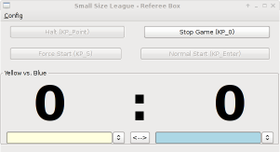

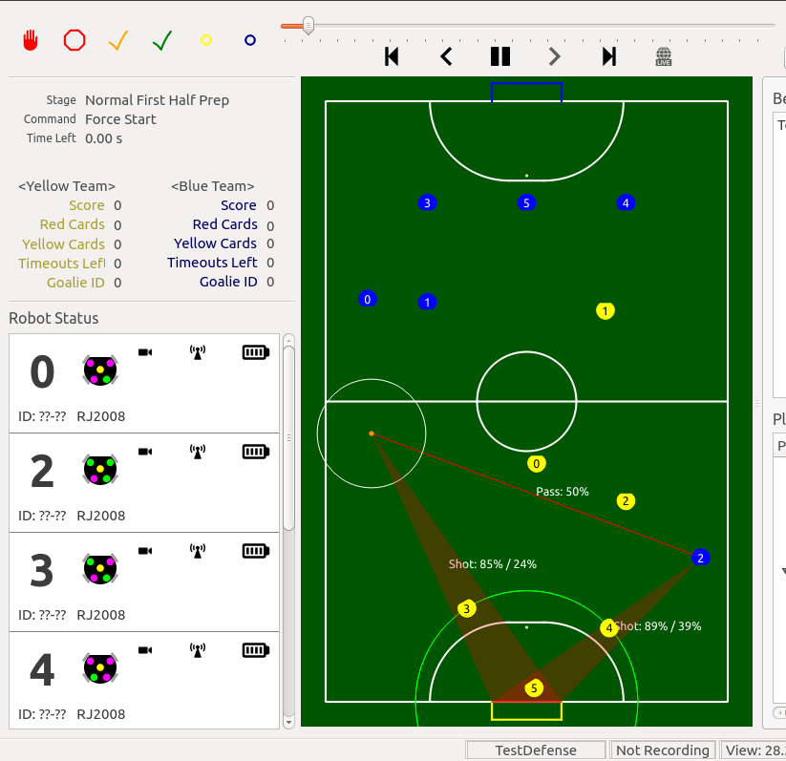

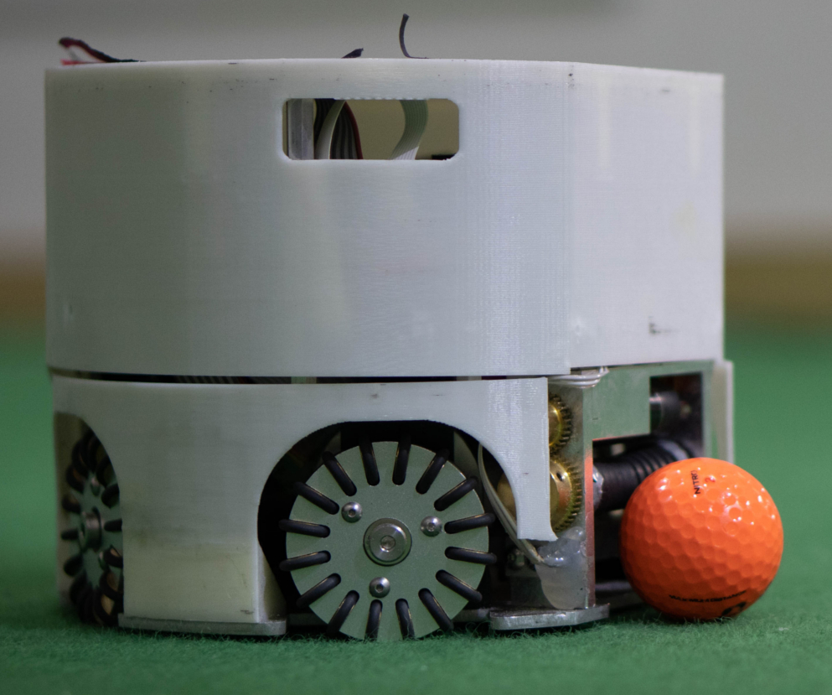
What’s in a game?
RefBox (and AutoRef)
SSL-Vision
WiFi Access Point
Robots
Soccer

Slide 14
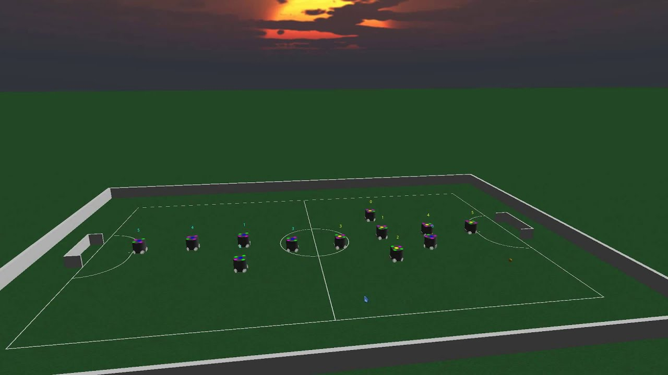
What’s in a simulated game?
Soccer (Blue)
grSim
RefBox (and AutoRef)
Soccer (Yellow)

Slide 15
Soccer: an Overview
main.py
Gameplay
RRTPlanner
Planning
Referee
Processor
MainWindow
Control
Radio
VisionFilter

Slide 16
Gameplay: Skills, Tactics, Plays
Skills are individual actions that one robot can do
Examples: kick, aim, capture, mark
Tactics are more complex behaviors that consist of multiple skills or multiple robots
Examples: defender, goalie, coordinated pass
Plays control all of the robots on the field, telling them which skills and tactics to use
Examples: “Basic 122” (simple offensive play), “Adaptive Formation” (more complex offense), “Clear” (clear the ball out from our side of the field
Situations the state that the game is in that will call specific plays.
Examples: their indirect kick, scramble, goalie clear, offense, and defense

Slide 17
Planning

Slide 18
Source Layout
soccer/
planning/ - motion planning code
gameplay/ - Python gameplay/strategy code
ui/ - Qt-based user interface code
vision/ - vision filtering code
Processor.cpp
common/ - common libraries and utilities, including Geometry2d

Slide 19
Questions?

Slide 20
The Twilight Zone
It’s not Python or Motion Planning!
QT5 UI
Boost
C++ to Python Bridge
Protobuf Packets
Joysticks
Logging
Build System

Slide 21
Soccer: an Overview
main.py
Gameplay
RRTPlanner
Planning
Referee
Processor
MainWindow
Control
Radio
VisionFilter

Slide 22
More Questions?

